Slide 1
실습 05 Sequential Logic

Slide 2
Lab 5
Design the following components. Verify with simulation results. Include in the report the design file (BDF), the captured “RTL view”, and the simulation waveform for each design.
  D latch with NAND gates in BDF
  D latch with Quartus Primitives in BDF
  D-FF with Quartus Primitives in BDF
  JK-FF with D-FF and Gates (AND, OR, NOT) of Quartus Primitives in BDF
  T-FF with D-FF and Gates (AND, OR, NOT) of Quartus Primitives in BDF

Slide 3
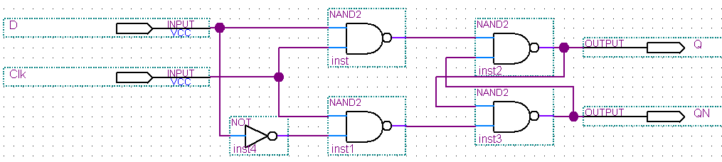
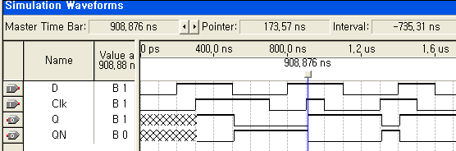
D latch with BDF

Slide 4
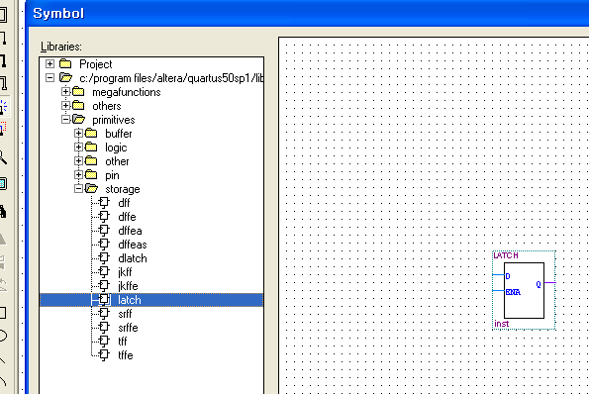
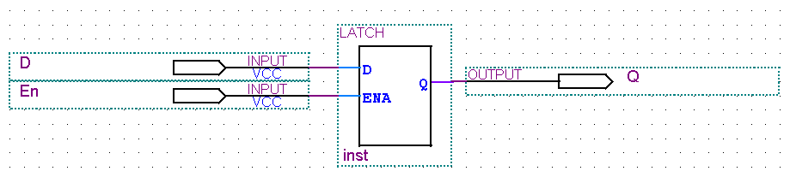
D latch simulation with Primitive
Insert the symbol latch

Slide 5
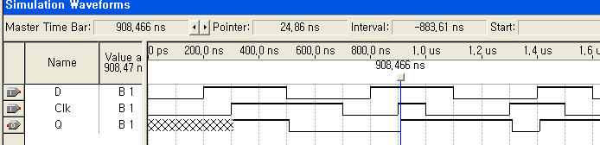
Simulation result with Primitive

Slide 6
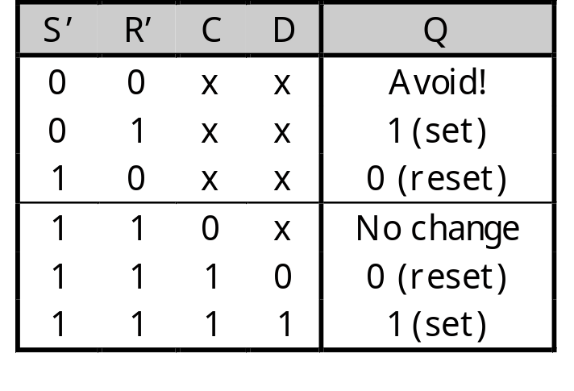
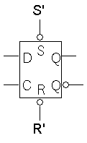
Direct inputs
Most flip-flops provide direct, or asynchronous, inputs that immediately sets or clears the state.
The below is a D flip-flop with active-low direct inputs.
Direct inputs to set or reset the flip-flop
S’R’ = 11 for “normal” operation of the D flip-flop

Slide 7
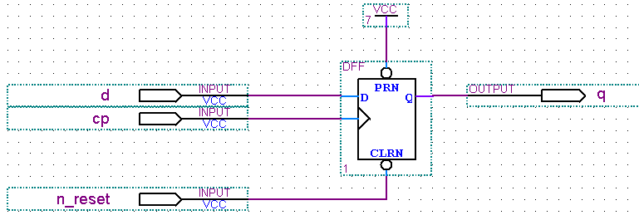
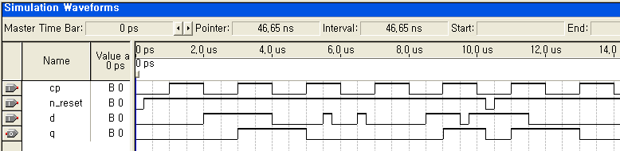
D FF with BDF
Insert the symbol dff
Edge-trigger symbol

Slide 8
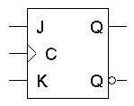
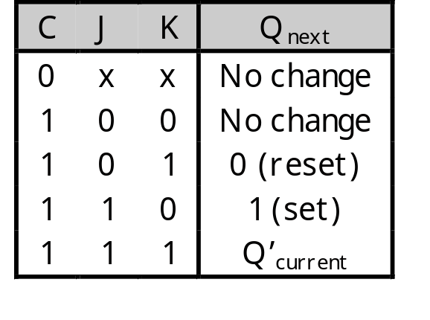
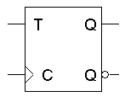
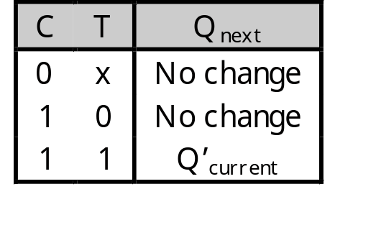
Flip-flop variations
We can make different versions of flip-flops based on the D flip-flop, just like we made different latches based on the S’R’ latch.
A JK flip-flop has inputs that act like S and R, but the inputs JK=11 are used to complement the flip-flop’s current state.
A T flip-flop can only maintain or complement its current state.

Slide 9
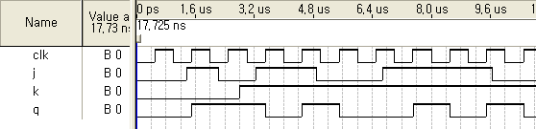
Design JK FF
set
toggle
reset

